Slide 1

Discussion Session Biomedical Foundation Models integration into TBDSS

Slide 2

AGNEDA
1. ABOUT GENEFORMER
2. ABOUT SC-FOUNDATION
3. DISCUSSION SESSION

Slide 3
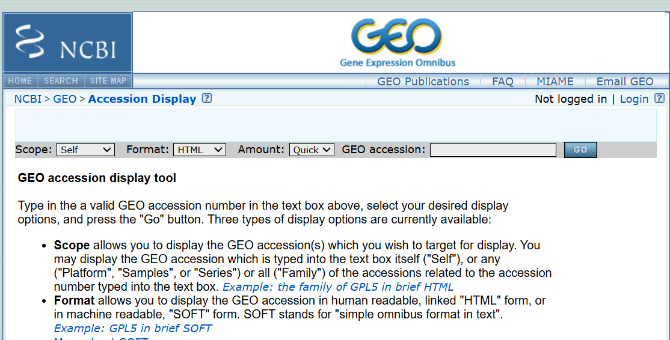
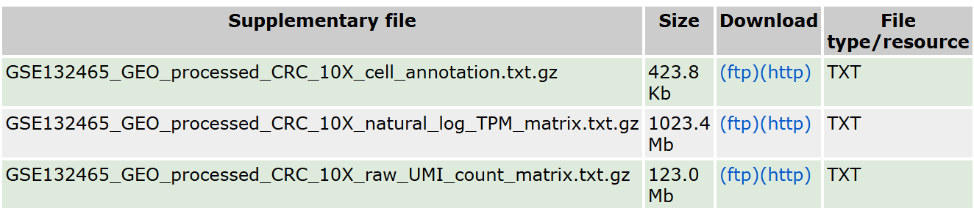
GENEFORMER’S INPUT DATA
Raw Count Matrix and cell annotation data (1GB + 100KB File)
Combined format
h5ad (14 GB)
.loom(3 GB)
Rank value Encodings
Hugging Face Dataset Format (356 MB)
Developed python code
(5 – 10 Mins)
Geneformer’s Tokenizer code
(5 Mins)

Slide 4
GENE PERTURBATION ANALYSIS SAMPLE WORKFLOW
Select the dataset (.HF format)
cell type
gene or gene pairs
Do Gene Perturbation
(Deletion or overexpression)
Pairs (eg gene1 , gene2) in all cells | 1- 2 Hrs
All genes Perturbing 1 at a time Analyzed in 100 cells | 7 hrs
Generate Cell Embeddings
Interpret results
(Cosine Similarity value)
Make a Fine tuned model
(1 Hrs- 2 Hrs)
Prtrained Model
(1- 2 mins)
Use Fine Tuned Model
(1- 2 mins)

Slide 5
SC-F’S INPUT DATA
Raw Count Matrix and cell annotation data (1GB + 100KB File)
Combined format
h5ad (14 GB)
Developed python code
(5 – 10 Mins)
Sc Foundations’s Tokenizer code
(5 Mins)

